Slide 1
Predictive Maintenance for Industrial Equipment

Slide 2
Introduction
The project focuses on predictive maintenance for industrial equipment. The idea is to use data to predict equipment failures before they happen and solve the problems to prevent losses.

Slide 3
Data Overview
Type Of Data:
Numerical Data: Such as temperature, pressure, operating speed, and vibrations
Text Data: Describing the condition of the equipment or recording previous issues
Image Data: Depicting the state of the equipment and used in classification using convolutional neural networks (CNN)
Logs: Collected to use NLP techniques to analyze key words and understand the overall condition
Data Cleaning:
Handling missing or incomplete values
Removing duplicate entries
Formatting data and converting types to ensure consistency and readiness for analysis.

Slide 4
libraries
gensim
matplotlib
nltk
numpy
pandas
seaborn
sklearn
textblob
pytourch

Slide 5
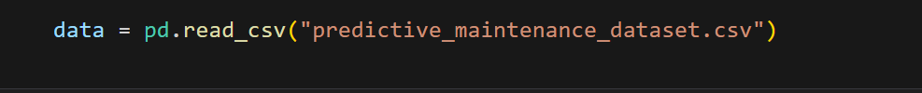
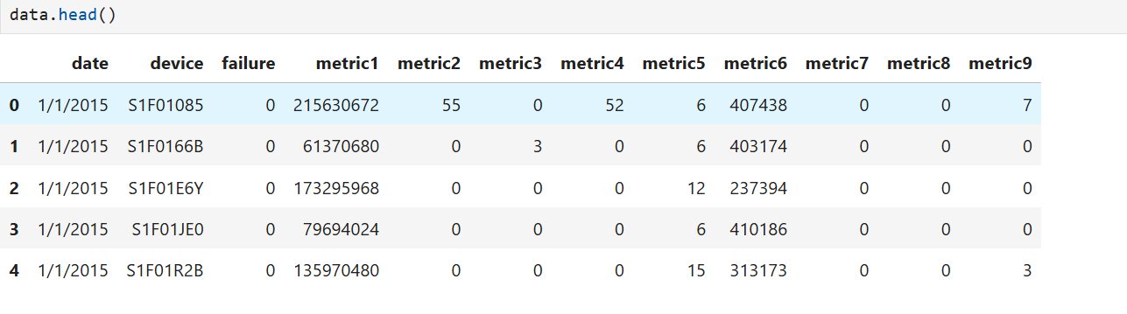
Loading the Dataset

Slide 6
Data Cleaning
Key Steps in Data Cleaning:
Handling Missing Values:
Identify missing values in the dataset.
Strategies:
Remove rows or columns with too many missing values.
Impute missing values using techniques like mean, median, or mode replacement.
Predictive Imputation with machine learning models.
Removing Duplicates:
Check for and remove duplicate entries to prevent data redundancy and ensure accuracy.
Fixing Structural Errors:
Identify and correct inconsistencies in data formatting, typos, or capitalization errors (e.g., "NY" vs. "New York").
Standardize units and categories for consistency.

Slide 7
Data cleaning
Outlier Detection and Treatment:
Identify outliers that can skew results.
Treatment:
Remove or Cap outliers based on domain knowledge.
Transform data using scaling or normalization.
Data Type Conversion:
Ensure data types are correctly formatted (e.g., numeric, date, string).
Convert data types to match analysis requirements, like converting strings to date formats or categorical data to numerical labels.
Feature Scaling and Encoding:
Scaling: Normalize or standardize numerical features for consistent ranges.
Encoding: Convert categorical data into numerical form using encoding techniques like one-hot encoding.
Text Data Cleaning (if applicable):
Process textual data by removing special characters, stopwords, and performing lemmatization/stemming for analysis

Slide 8
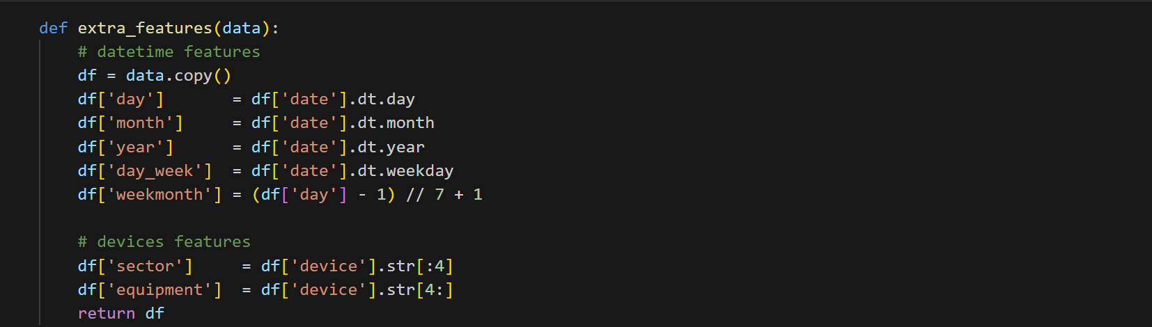
Our Data is already clean we Don’t use data cleaning

Slide 9
Exploratory Data Analysis (EDA)
The purpose of EDA is to understand the relationships between the variables and data, and to identify patterns that may help predict failures.
Libraries like pandas, matplotlib, and seaborn were used to create visualizations and analyze the results visually.

Slide 10
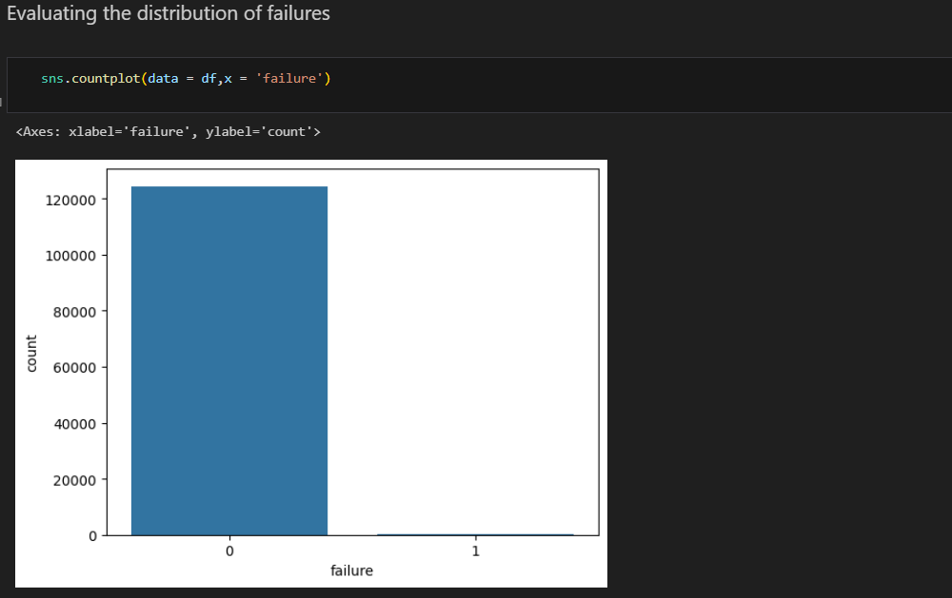
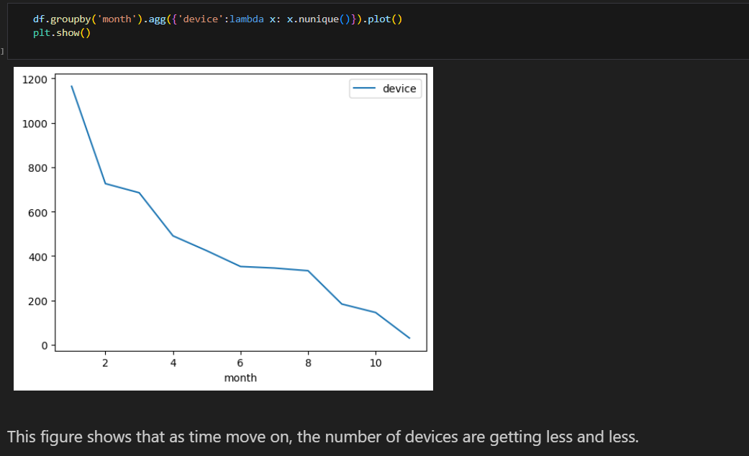

Slide 11
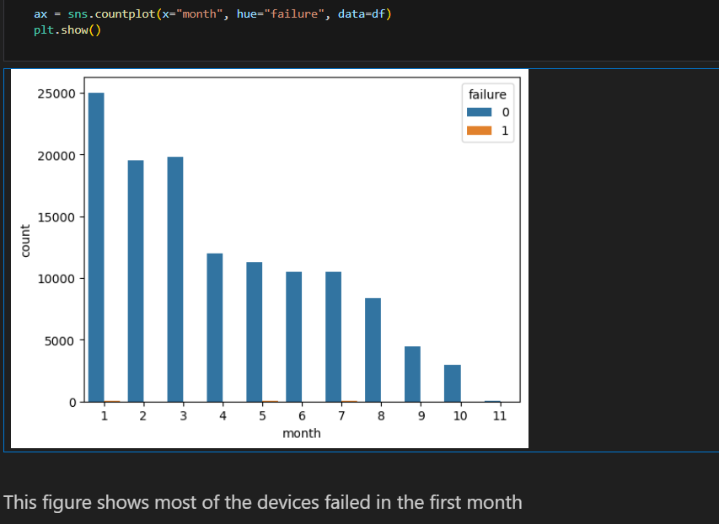
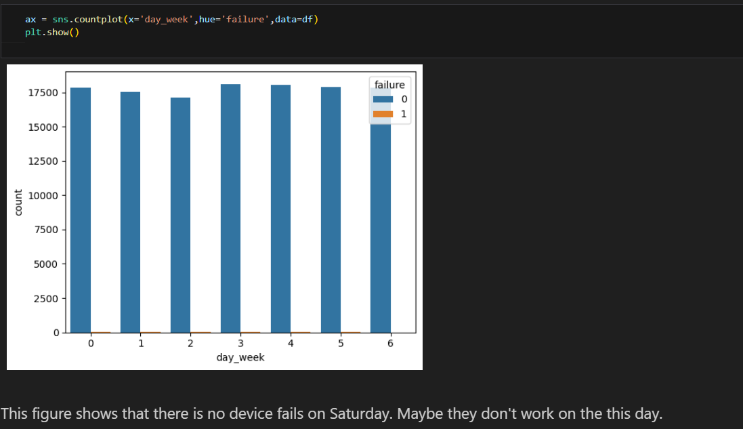

Slide 12
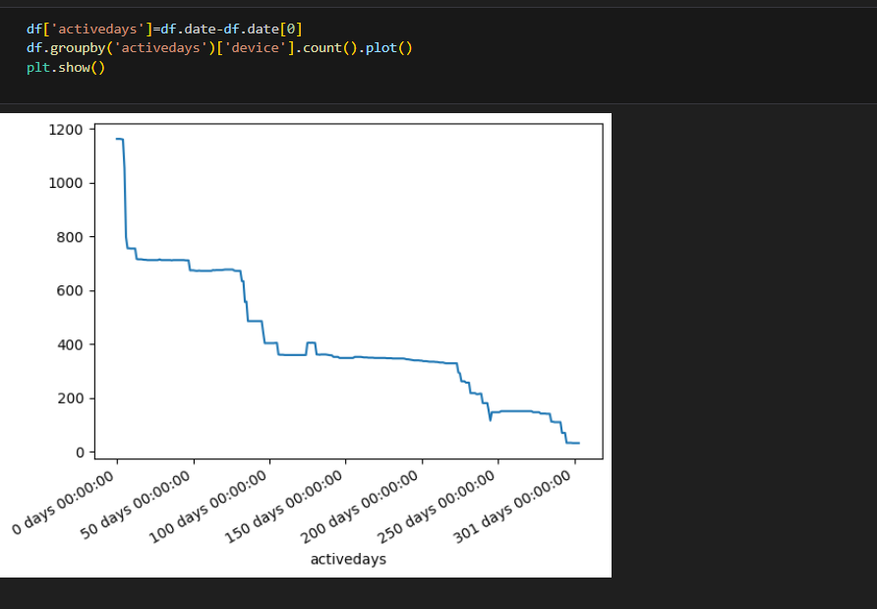
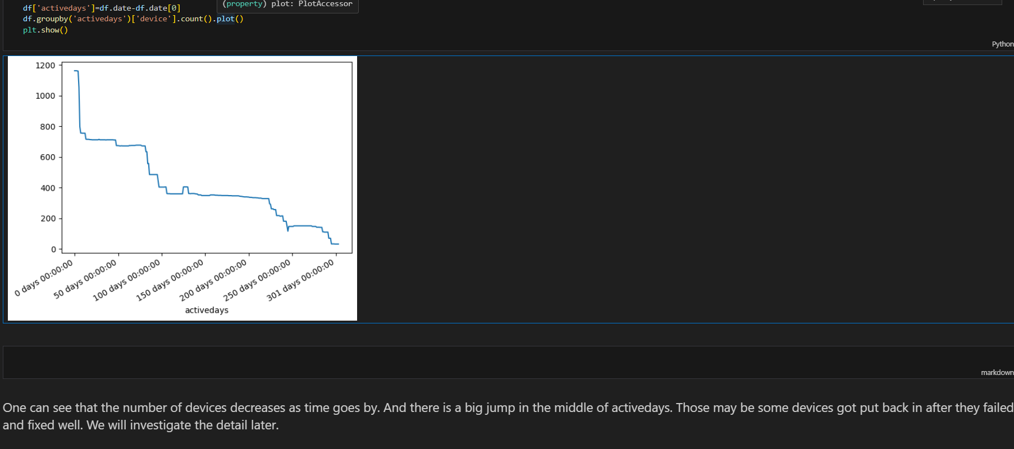

Slide 13
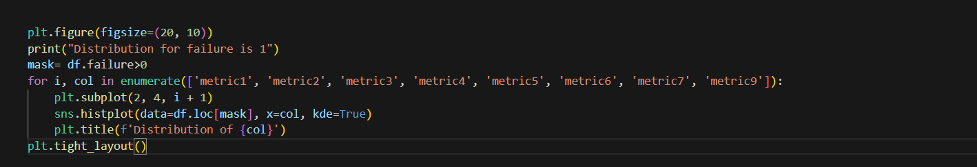
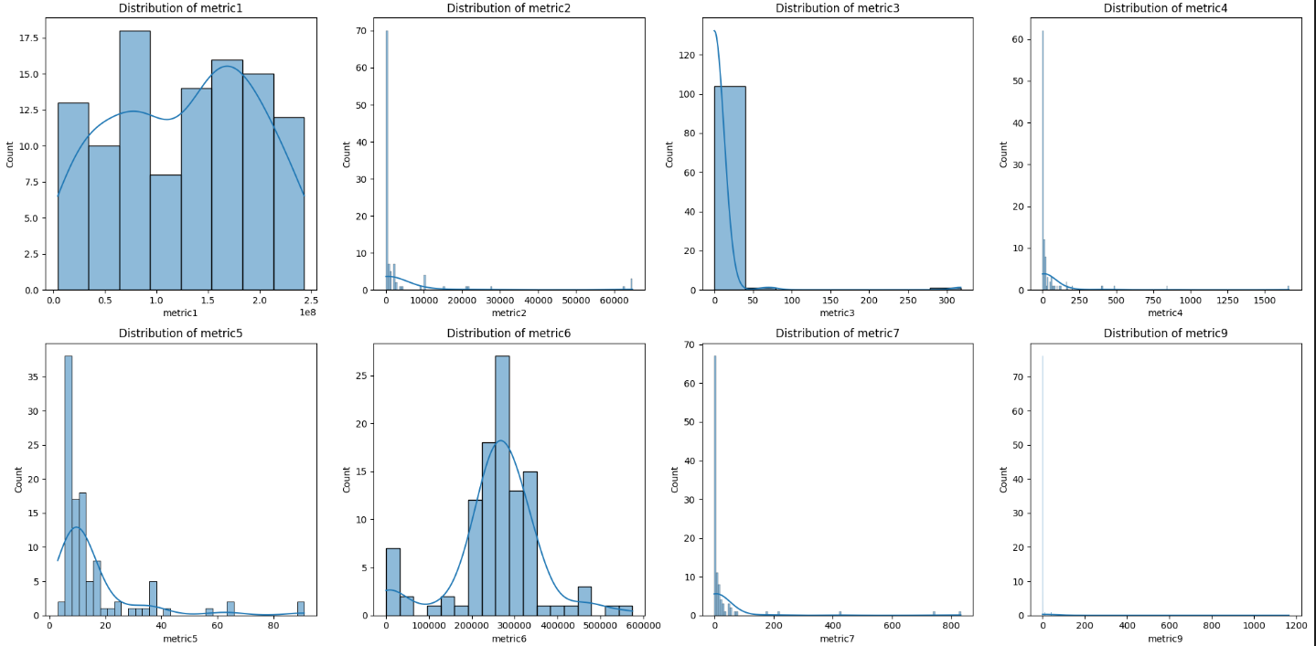

Slide 14
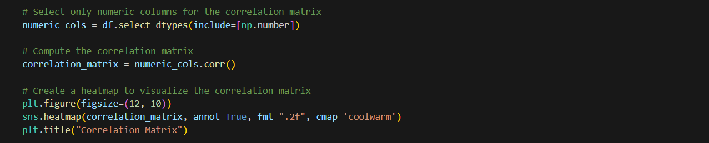
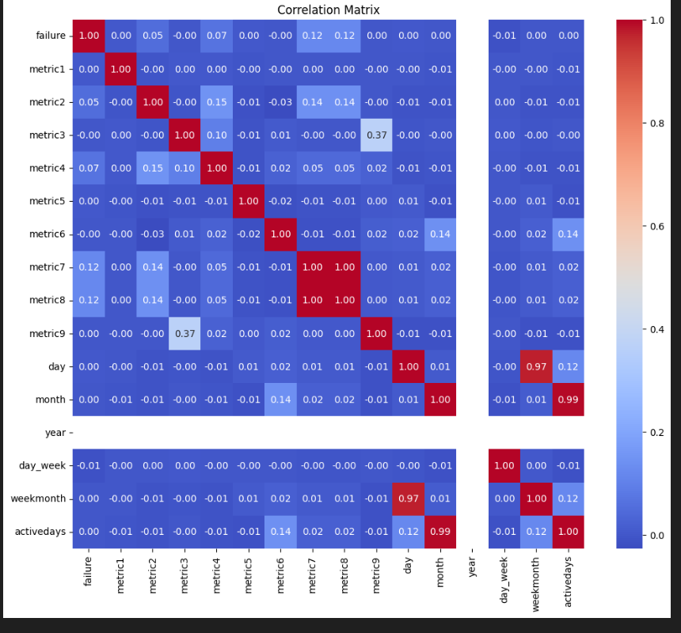

Slide 15
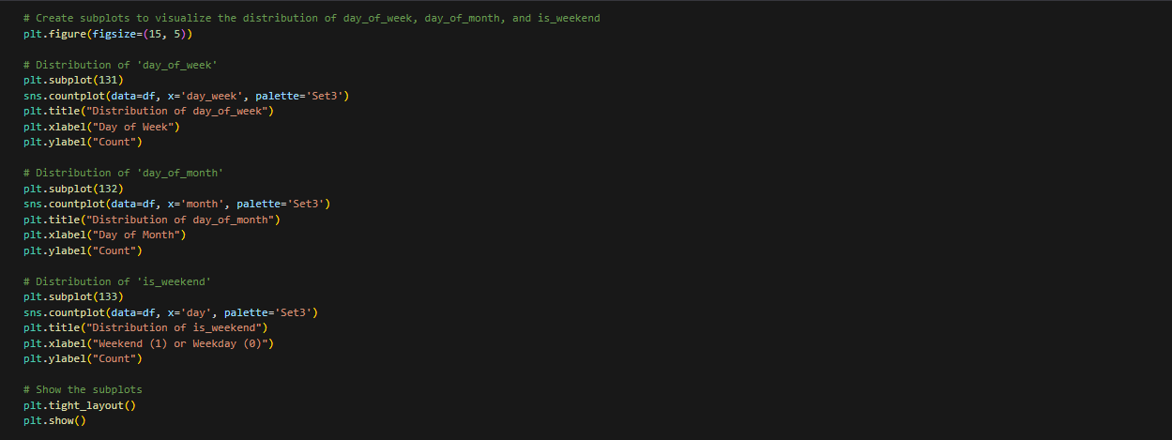
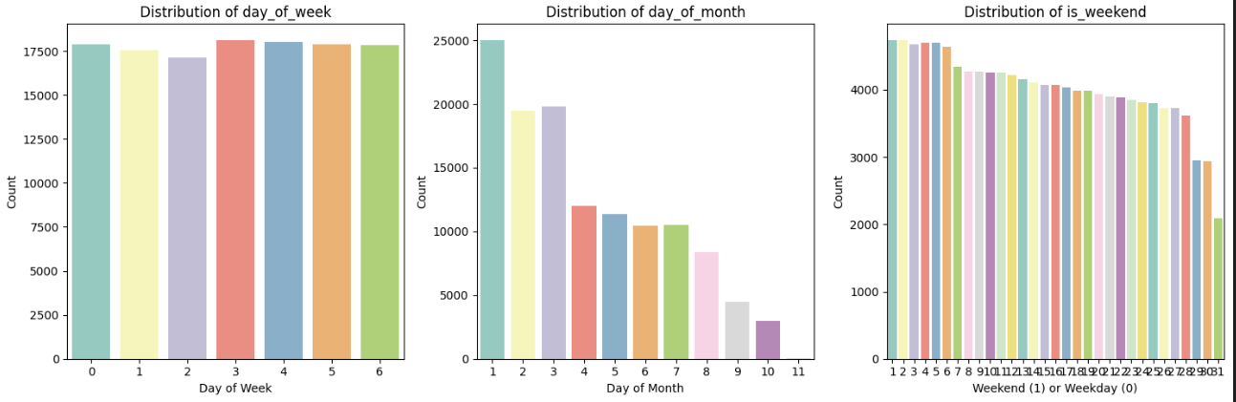

Slide 16
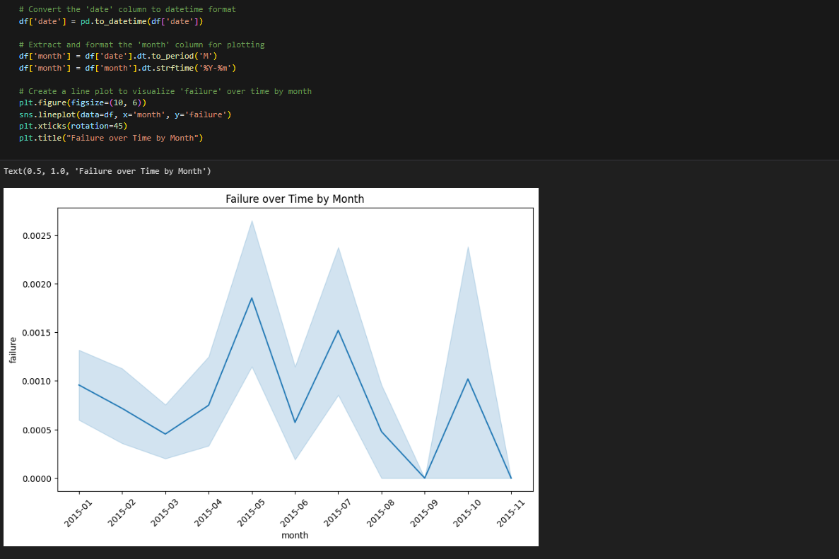

Slide 17
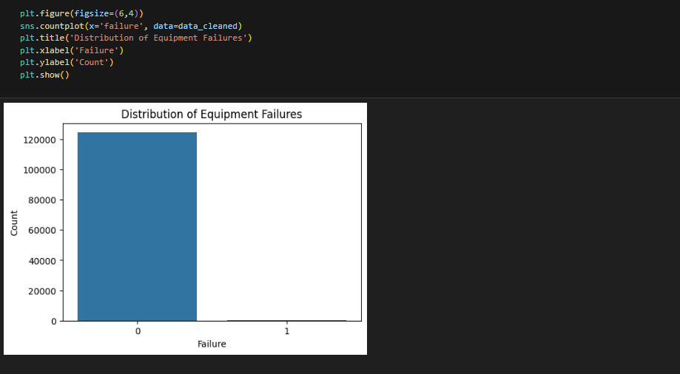
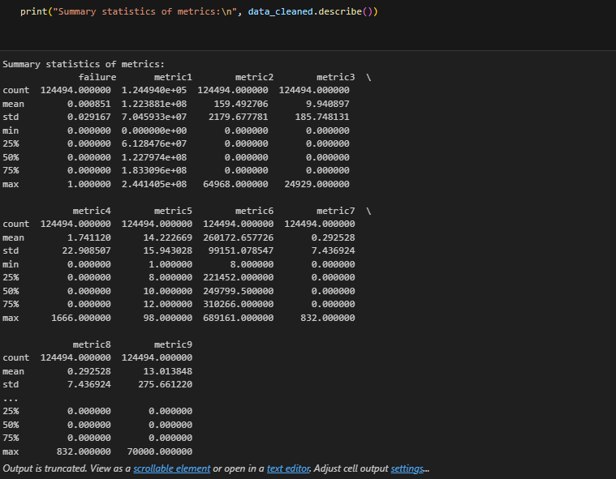

Slide 18
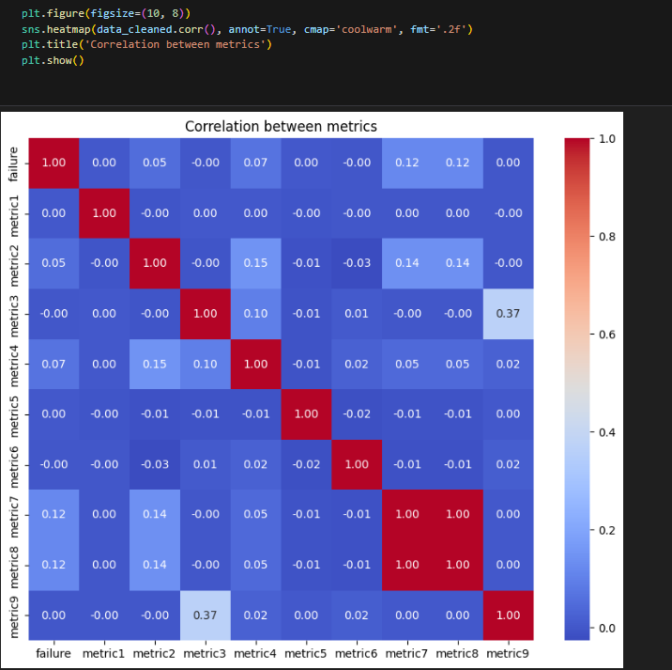
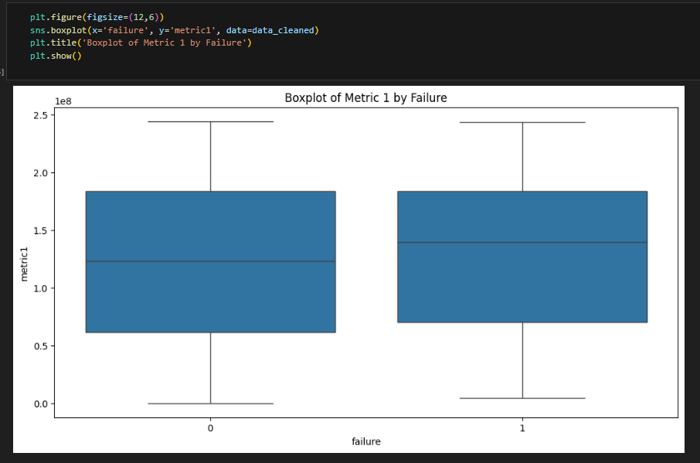

Slide 19
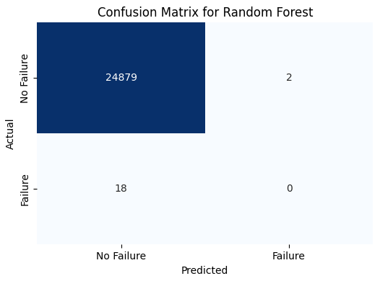
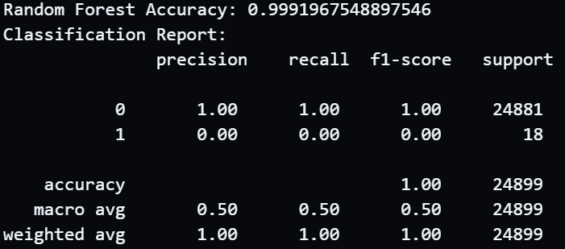
Machine Learning
RandomForestClassifier:
Purpose: Used to classify the data and predict equipment failures.
Process:
Split the data into training and testing sets.
Trained the model using the training set.
Predicted outcomes on the test set and evaluated accuracy using a confusion matrix.
Results: The model achieved a certain level of accuracy, as shown in the confusion matrix.

Slide 20
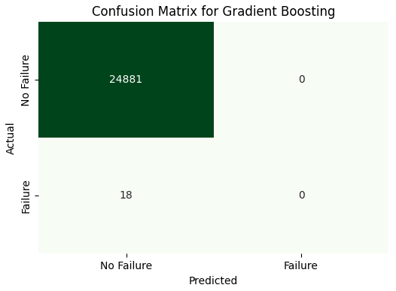
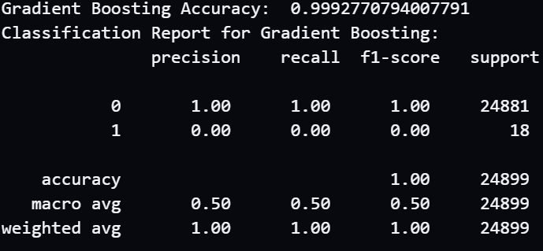
Machine Learning
GradientBoostingClassifier:
Purpose: Applied to classify the data and improve prediction accuracy by reducing errors from previous models.
Process:
Divided the dataset into training and testing subsets.
Trained the model incrementally on the training set, optimizing each step based on errors from previous steps.
Predicted on the test set and measured performance using a confusion matrix and accuracy score.
Results: The model demonstrated improved accuracy, with results highlighted in the confusion matrix.

Slide 21
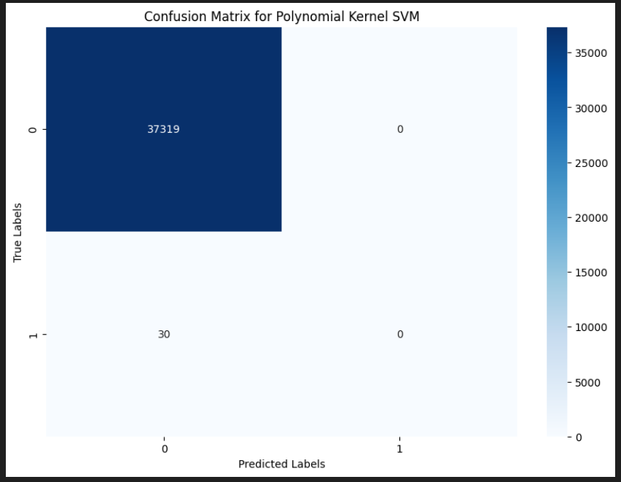
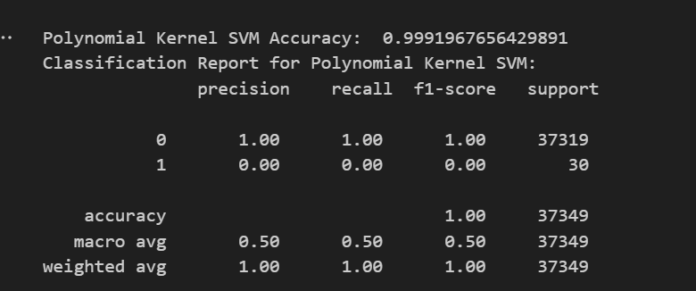
Support Vector Machine (SVM):
Purpose: SVM with a polynomial kernel was used to capture non-linear relationships in the data.
Process:
Used the training and testing sets as with the Decision Tree.
Evaluated performance through accuracy and a classification report.
Results: The model's effectiveness was visualized with a confusion matrix.

Slide 22
NLP
Natural Language Processing (NLP)
Log Processing:
Created logs to capture device status and metrics.
Preprocessed these logs by tokenizing, removing stopwords, and lemmatizing.
TF-IDF Vectorization:
Used to find the most significant words in the logs.
Word2Vec:
Represented words as vectors to capture semantic meaning for further analysis.
Sentiment Analysis:
Purpose: Used TextBlob to calculate sentiment polarity in logs, giving insights into device failures.
Topic Modeling with LDA:
Purpose: Extracted common topics from logs using the LDA model to uncover recurring patterns in device issues

Slide 23
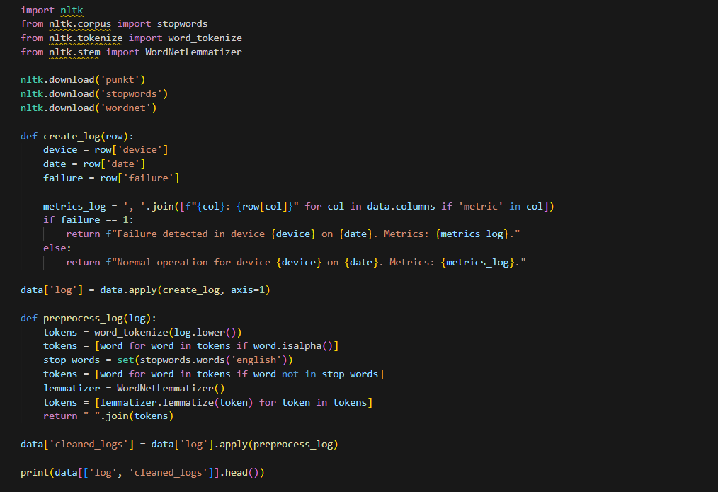
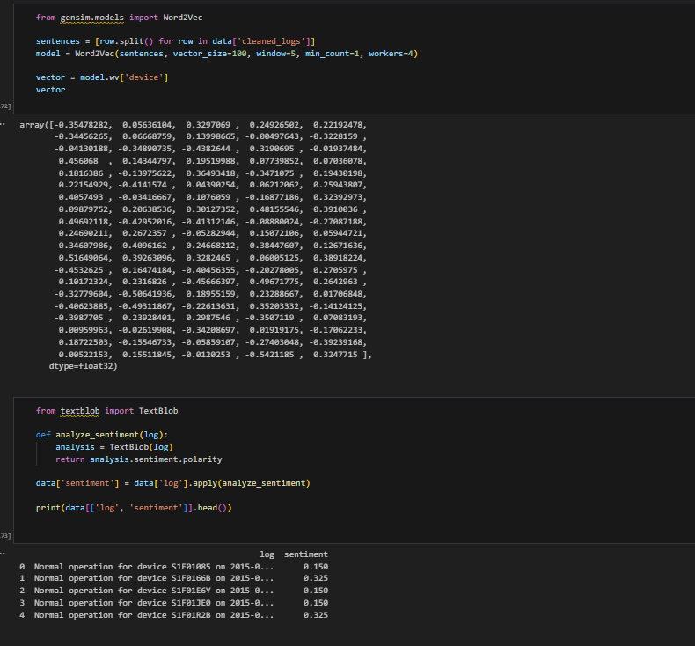
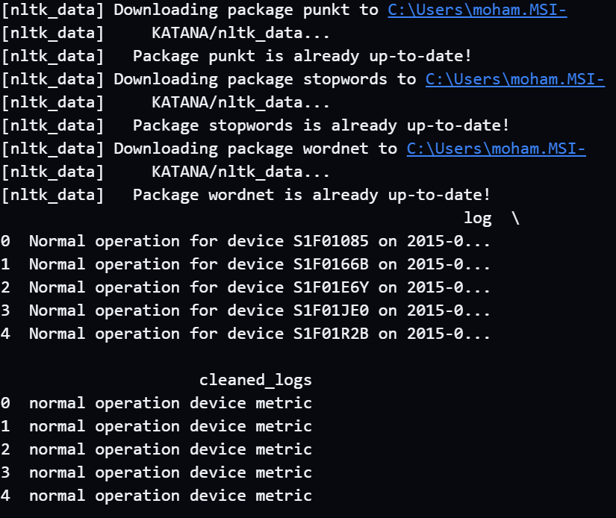

Slide 24
Generative Data Generation (Generative Adversarial Network - GAN)
A GAN model was used to generate synthetic industrial data, increasing the dataset size and improving accuracy.
we’re doing well with the GAN setup! To enhance your approach:
Experiment with different architectures such as DCGAN for image-based synthetic data generation or implement Wasserstein GAN (WGAN) for more stable training in general.
Additionally, we utilized MLflow to track the training process and logged various readings throughout. Initially, the readings were not satisfactory, but they improved and were adjusted as training progressed.

Slide 25
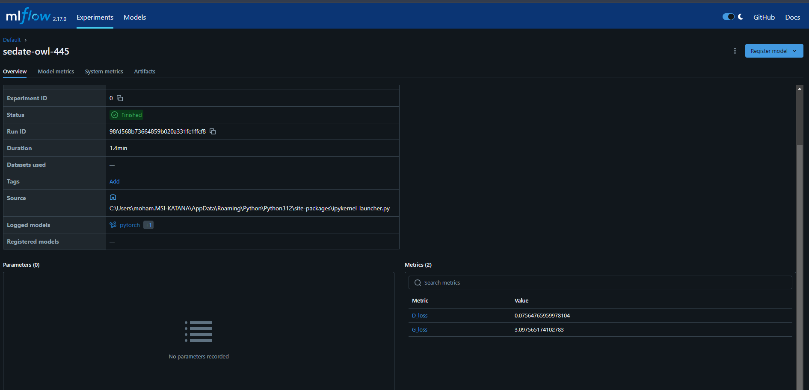

Before Edit
Value | Metric
0.07564765959978104 | D_loss
3.097565174102783 | G_loss

Slide 26
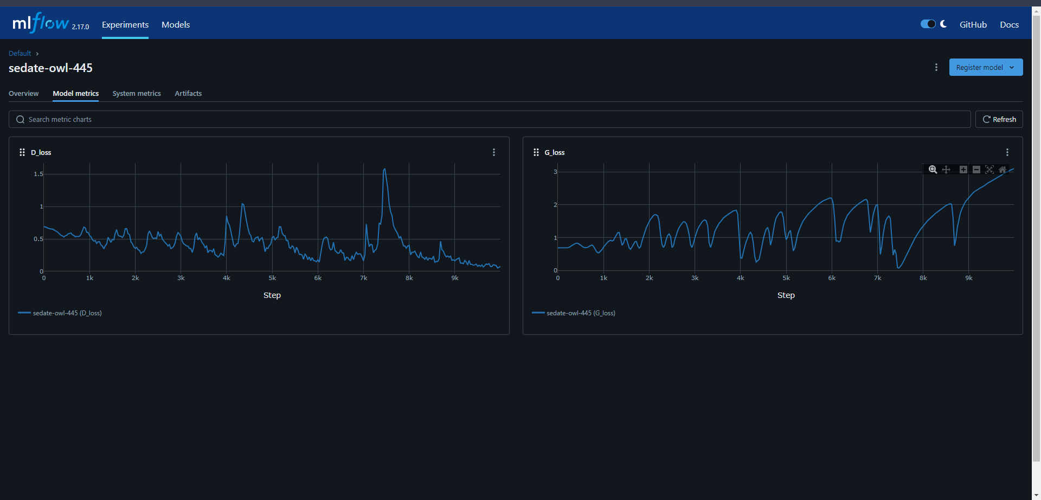

Slide 27
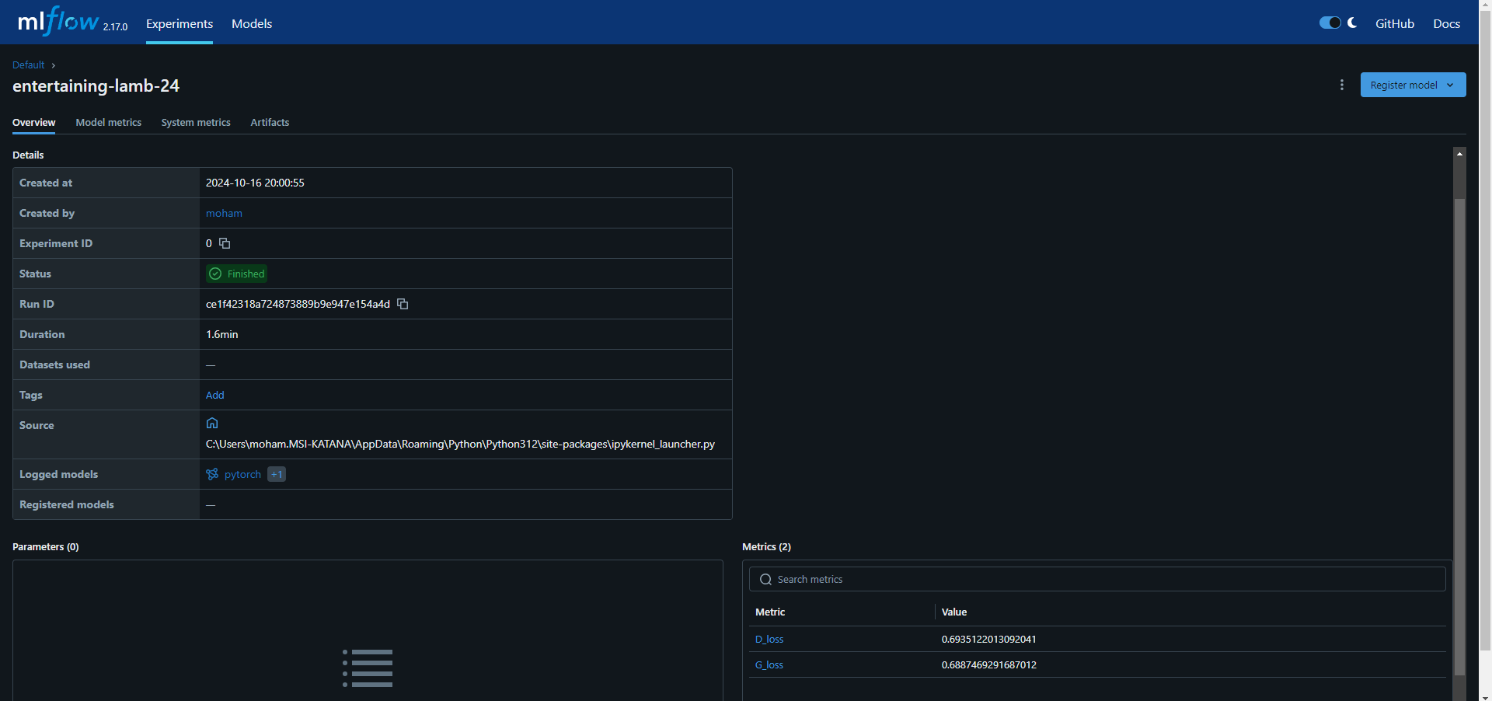
After Edit
Value | Metric
0.6935122013092041 | D_loss
0.6887469291687012 | G_loss

Slide 28
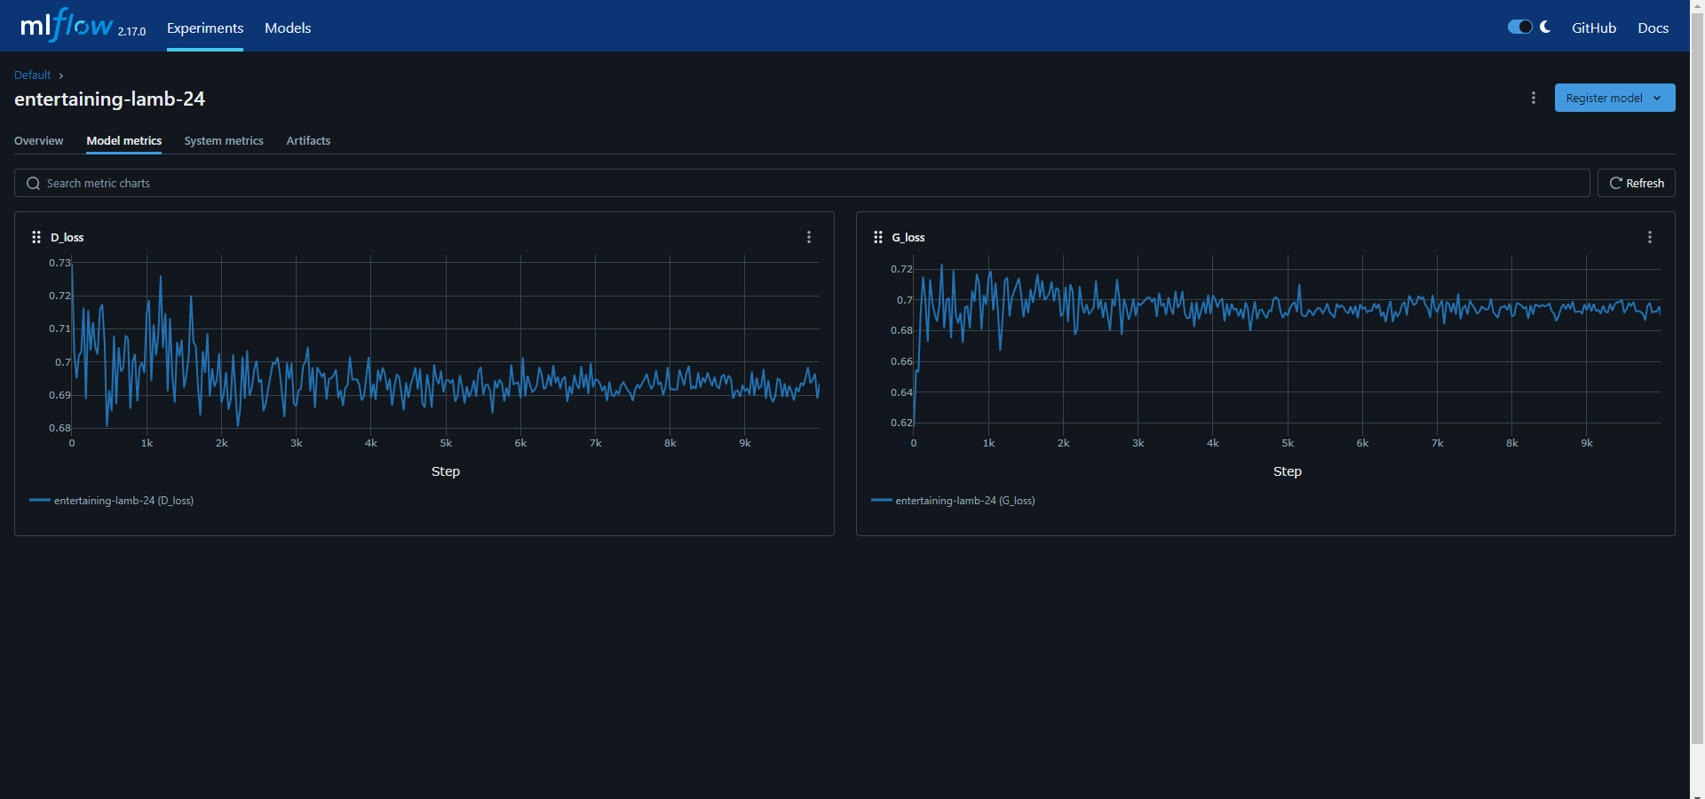

Slide 29
Computer Vision
we’re using a CNN for image classification, which is great. However:
Consider data augmentation techniques (such as flipping, rotating, and scaling) for the images, which can help improve generalization, especially if you have a limited dataset.
A CNN (Convolutional Neural Network) model was applied to classify images and detect equipment status. Pre-trained models like ResNet or MobileNet were considered to enhance performance.

Slide 30
Deployment and Monitoring
Once you have a model that performs well:
Consider model deployment using frameworks like Flask or FastAPI to create an API for real-time prediction.
Monitor model performance using MLflow or other tools for drift detection, and set up alerts if the model starts underperforming on incoming data.

Slide 31
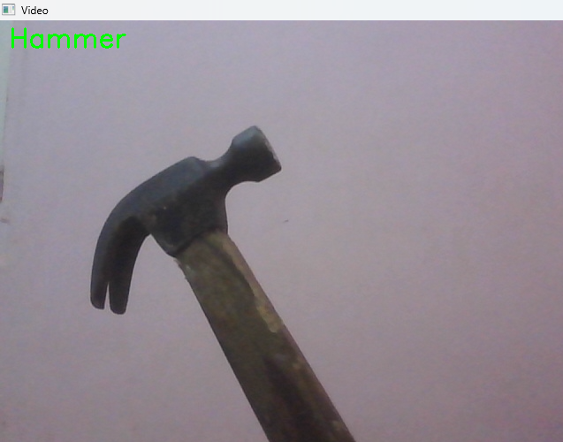
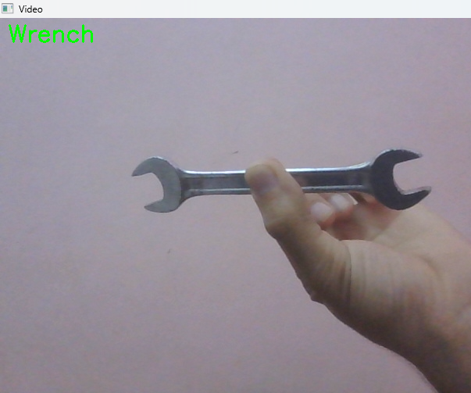
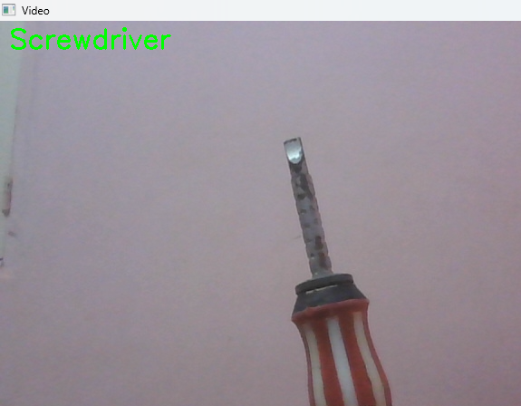

Slide 32
Plan for the Report and Presentation:
Final Report:
Introduction: Overview of predictive maintenance and its benefits.
Data Description: Types of data, acquisition, and cleaning process.
Exploratory Data Analysis: Visualizations and patterns.
Models Used: Explanation of each model and its results.
NLP: Text analysis and topic extraction.
Computer Vision: How images were used for classification.
Data Generation: The role of GAN in improving data.
Deployment and Monitoring: How the model was deployed and monitored.

